Slide 1
Lecture 2: Learning with neural networks
Deep Learning @ UvA

Slide 2
Lecture Overview
Machine Learning Paradigm for Neural Networks
The Backpropagation algorithm for learning with a neural network
Neural Networks as modular architectures
Various Neural Network modules
How to implement and check your very own module

Slide 3

The Machine Learning Paradigm

Slide 4
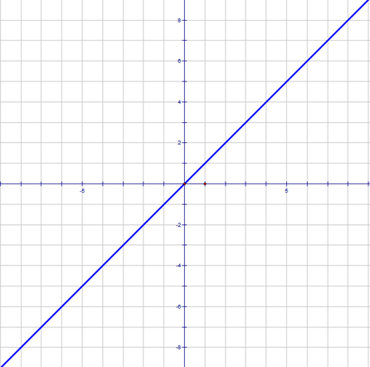
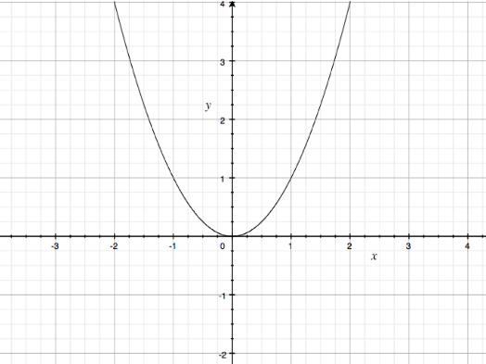



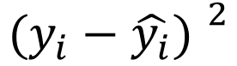

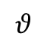

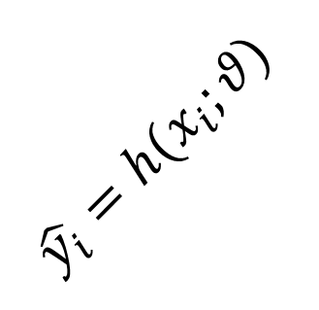
Forward computations
Collect annotated data
Define model and initialize randomly
Predict based on current model
In neural network jargon “forward propagation”
Evaluate predictions
Model
Score/Prediction/Output
Objective/Loss/Cost/Energy
$$h(x_{i};θ)$$
$$\hat{y_{i}}∝h(x_{i};θ)$$
$$ℒ(θ;\hat{y_{i}}, h)$$
Data
Input:
$$X$$
$$\hat{y_{i}}=h(x_{i};θ)$$
Targets:
$$θ$$
$$Y$$
$${(y_{i}−\hat{y_{i}}) }^{2}$$

Slide 5

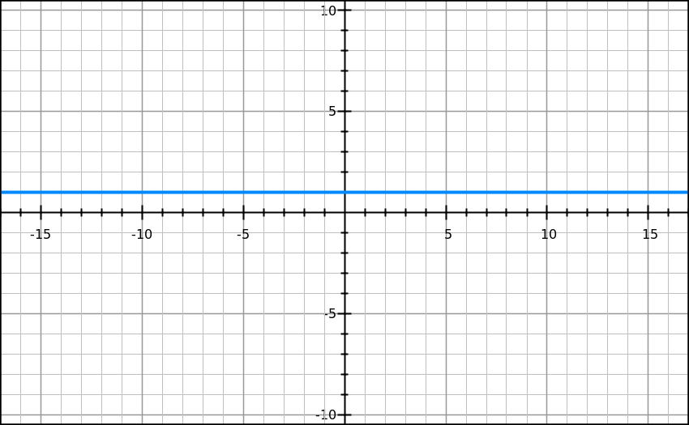
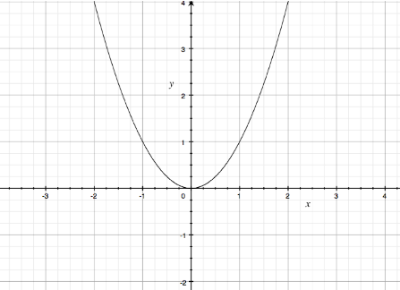
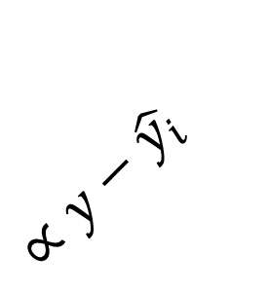



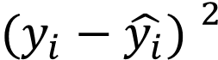

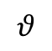



Backward computations
Collect gradient data
Define model and initialize randomly
Predict based on current model
In neural network jargon “backpropagation”
Evaluate predictions
Model
Score/Prediction/Output
Objective/Loss/Cost/Energy
$$\frac{∂h(x_{i})}{∂θ}$$
$$\frac{∂\hat{y_{i}}}{∂h}$$
$$\frac{∂ℒ(θ;\hat{y_{i}})}{∂\hat{y_{i}}}$$
Data
$$ℒ( )$$
Input:
$$X$$
$$\hat{y_{i}}=h(x_{i};θ)$$
$$=1$$
Targets:
$$Y$$
$$θ$$
$$∝y−\hat{y_{i}}$$
$${(y_{i}−\hat{y_{i}}) }^{2}$$

Slide 6
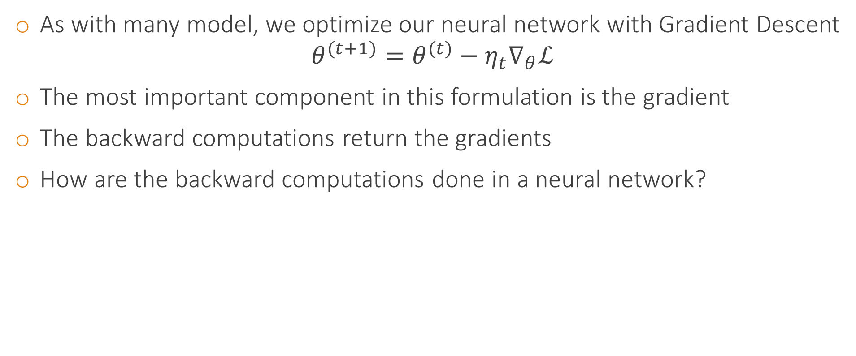
Optimization through Gradient Descent
As with many model, we optimize our neural network with Gradient Descent
$$θ^{(t+1)}=θ^{(t)}−η_{t}∇_{θ}ℒ$$
The most important component in this formulation is the gradient
The backward computations return the gradients
How are the backward computations done in a neural network?

Slide 7
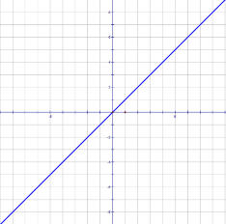
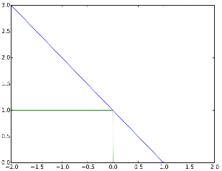
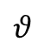
Example: Neural network with hinge loss
Forward propagation
Backpropagation
$$θ$$

Slide 8
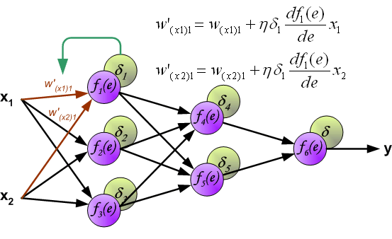
Backpropagation

Slide 9
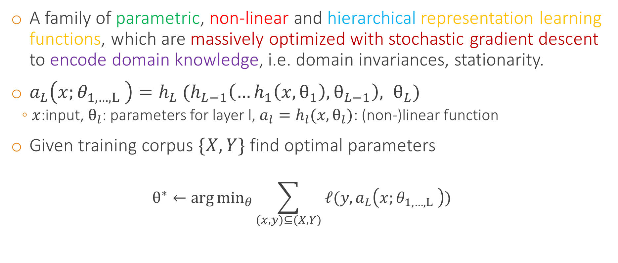
What is a neural network again?
A family of parametric, non-linear and hierarchical representation learning functions, which are massively optimized with stochastic gradient descent to encode domain knowledge, i.e. domain invariances, stationarity.
$a_{L}\left(x;θ_{1,…,L} \right)=h_{L} (h_{L−1}\left(…h_{1}\left(x,θ_{1}\right),θ_{L−1}\right), θ_{L})$
$x$:input, $θ_{l}$: parameters for layer l, $a_{l}=h_{l}(x,θ_{l})$: (non-)linear function
Given training corpus $\{X, Y\}$ find optimal parameters
$$θ^{∗}←\arg{\min_{θ}{\sum_{(x,y)⊆(X, Y)}{ℓ(y,a_{L}\left(x;θ_{1,…,L} \right))}}}$$

Slide 10



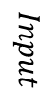
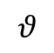



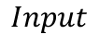










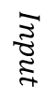





Again, what is a neural network model?
A neural network model is a series of hierarchically connected functions
This hierarchies can be very, very complex
Forward connections
(Feedforward architecture)
$$Input$$
$$h_{1}(x_{i};θ)$$
$$h_{2}(x_{i};θ)$$
$$h_{3}(x_{i};θ)$$
$$h_{4}(x_{i};θ)$$
$$h_{5}(x_{i};θ)$$
$$Loss$$
$$h(x_{i};θ)$$
$$h_{2}(x_{i};θ)$$
$$h_{3}(x_{i};θ)$$
$$h_{5}(x_{i};θ)$$
Functions are implemented as Modules
Interweaved connections (Directed Acyclic Graph architecture- DAGNN)
Functions
$$Input$$
$$h_{1}(x_{i};θ)$$
$$h_{4}(x_{i};θ)$$
$$Loss$$
$$θ$$
$$h_{2}(x_{i};θ)$$
$$h_{4}(x_{i};θ)$$
$$Input$$
$$h_{1}(x_{i};θ)$$
$$h_{2}(x_{i};θ)$$
$$h_{3}(x_{i};θ)$$
$$h_{4}(x_{i};θ)$$
$$h_{5}(x_{i};θ)$$
$$Loss$$
Loopy connections (Recurrent architecture, special care needed)

Slide 11
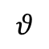

Neural network models
A neural network model is a series of hierarchically connected functions
This hierarchies can be very, very complex
Forward connections
(Feedforward architecture)
$$Input$$
$$h_{1}(x_{i};θ)$$
$$h_{2}(x_{i};θ)$$
$$h_{3}(x_{i};θ)$$
$$h_{4}(x_{i};θ)$$
$$h_{5}(x_{i};θ)$$
$$Loss$$
$$h(x_{i};θ)$$
Functions are implemented as Modules
$$h_{2}(x_{i};θ)$$
$$h_{3}(x_{i};θ)$$
$$h_{5}(x_{i};θ)$$
Interweaved connections (Directed Acyclic Graph architecture- DAGNN)
Functions
$$Input$$
$$h_{1}(x_{i};θ)$$
$$h_{4}(x_{i};θ)$$
$$Loss$$
$$θ$$
$$h_{2}(x_{i};θ)$$
$$h_{4}(x_{i};θ)$$
$$Input$$
$$h_{1}(x_{i};θ)$$
$$h_{2}(x_{i};θ)$$
$$h_{3}(x_{i};θ)$$
$$h_{4}(x_{i};θ)$$
$$h_{5}(x_{i};θ)$$
$$Loss$$
Loopy connections (Recurrent architecture, special care needed)

Slide 12
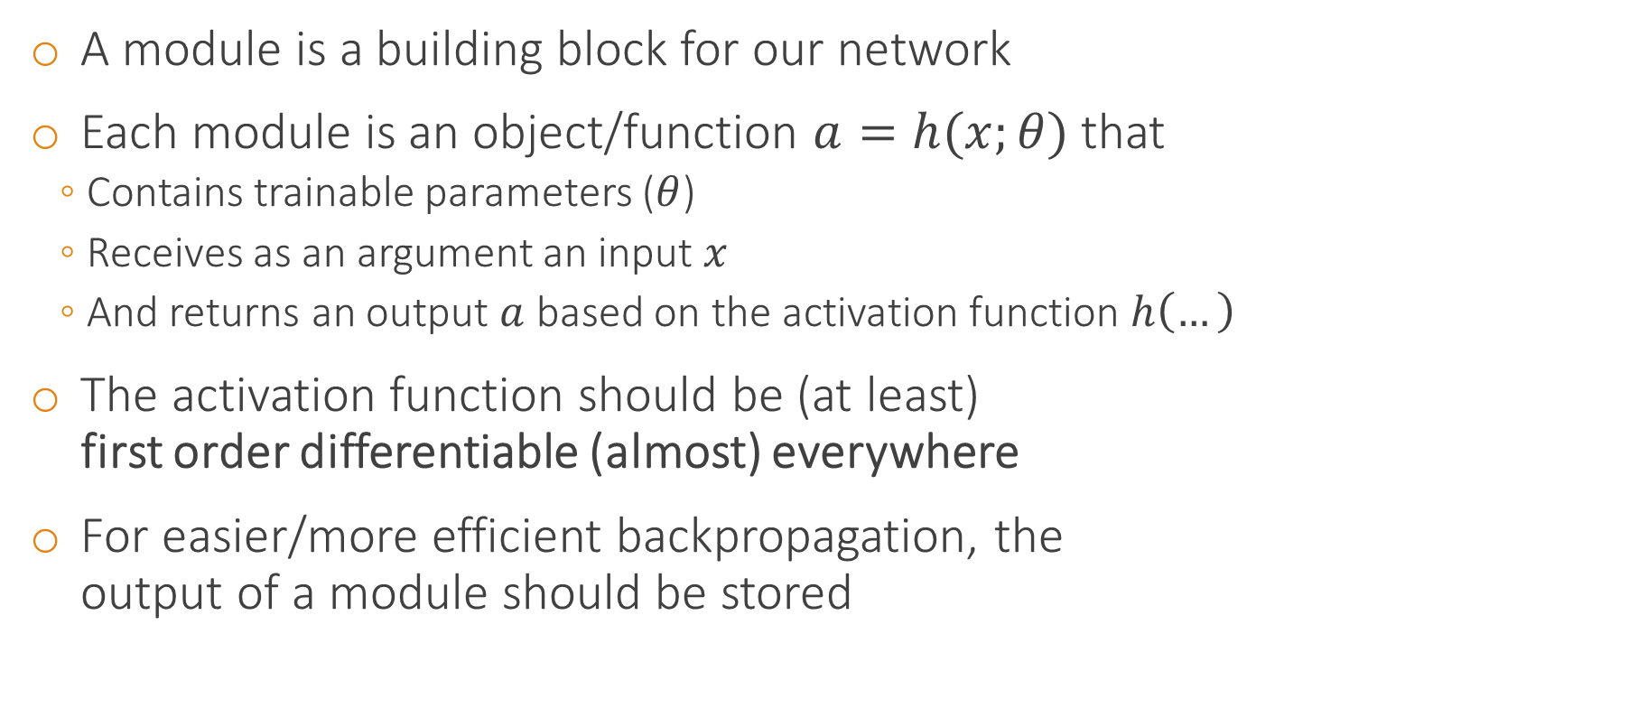





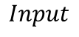



What is a module?
A module is a building block for our network
Each module is an object/function $a=h(x;θ)$ that
Contains trainable parameters ($θ$)
Receives as an argument an input $x$
And returns an output $a$ based on the activation function $h\left(…\right)$
The activation function should be (at least) first order differentiable (almost) everywhere
For easier/more efficient backpropagation, the output of a module should be stored
$$h_{2}(x_{2};θ_{2})$$
$$h_{3}(x_{3};θ_{3})$$
$$h_{5}(x_{5};θ_{5})$$
$$Input$$
$$h_{1}(x_{1};θ_{1})$$
$$h_{4}(x_{4};θ_{4})$$
$$Loss$$
$$h_{2}(x_{2};θ_{2})$$
$$h_{5}(x_{5};θ_{5})$$
Notes:
Socrative on differentiable

Slide 13
Anything goes or do special constraints exist?
A neural network is a composition of modules (building blocks)
Any architecture works
If the architecture is a feedforward cascade, no special care
If acyclic, there is right order of computing the forward computations
If there are loops, these form recurrent connections (revisited later)

Slide 14



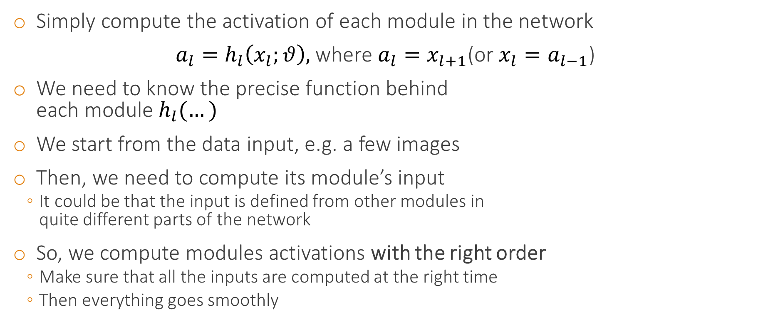






Forward computations for neural networks
Simply compute the activation of each module in the network
$a_{l}=h_{l}\left(x_{l};θ\right),$where $a_{l}=x_{l+1}$(or $x_{l}=a_{l−1}$)
We need to know the precise function behind each module $h_{l}(…)$
We start from the data input, e.g. a few images
Then, we need to compute its module’s input
It could be that the input is defined from other modules in quite different parts of the network
So, we compute modules activations with the right order
Make sure that all the inputs are computed at the right time
Then everything goes smoothly
$$Loss$$
$$h_{5}(x_{5};θ_{5})$$
$$h_{5}(x_{5};θ_{5})$$
$$h_{4}(x_{4};θ_{4})$$
$$h_{3}(x_{3};θ_{3})$$
$$h_{2}(x_{2};θ_{2})$$
$$h_{2}(x_{2};θ_{2})$$
$$h_{1}(x_{1};θ_{1})$$
Data:
$$Input$$

Slide 15
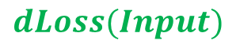


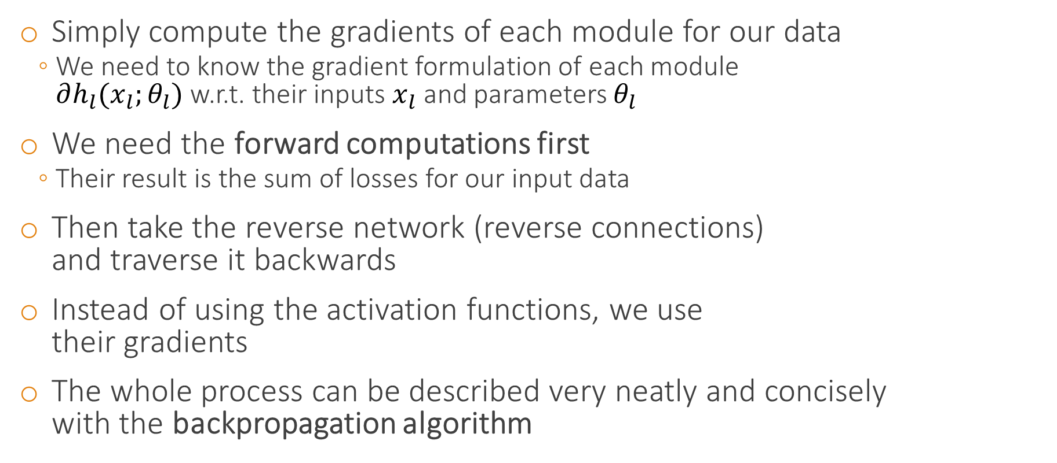





Backward computations for neural networks
Data:
$$dLoss(Input)$$
Simply compute the gradients of each module for our data
We need to know the gradient formulation of each module $∂h_{l}(x_{l};θ_{l})$ w.r.t. their inputs $x_{l}$ and parameters $θ_{l}$
We need the forward computations first
Their result is the sum of losses for our input data
Then take the reverse network (reverse connections) and traverse it backwards
Instead of using the activation functions, we use their gradients
The whole process can be described very neatly and concisely with the backpropagation algorithm
$${dh}_{5}(x_{5};θ_{5})$$
$$dh_{5}(x_{5};θ_{5})$$
$$dh_{4}(x_{4};θ_{4})$$
$${dh}_{3}(x_{3};θ_{3})$$
$$dh_{2}(x_{2};θ_{2})$$
$${dh}_{2}(x_{2};θ_{2})$$
$$dh_{1}(x_{1};θ_{1})$$

Slide 16
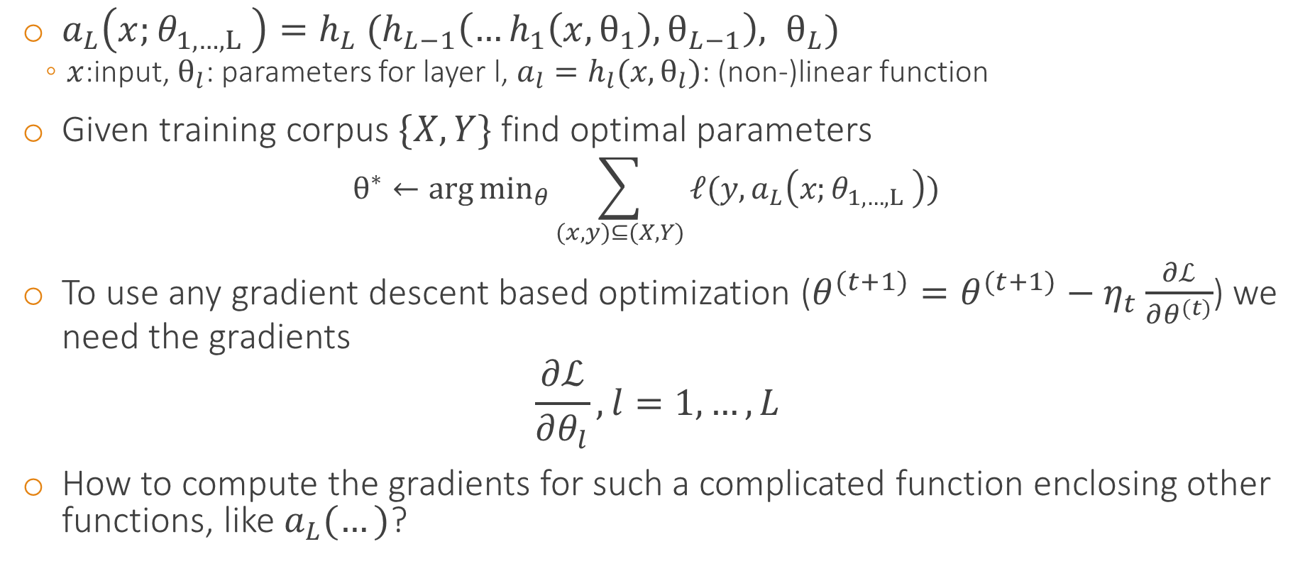
Again, what is a neural network again?
$a_{L}\left(x;θ_{1,…,L} \right)=h_{L} (h_{L−1}\left(…h_{1}\left(x,θ_{1}\right),θ_{L−1}\right), θ_{L})$
$x$:input, $θ_{l}$: parameters for layer l, $a_{l}=h_{l}(x,θ_{l})$: (non-)linear function
Given training corpus $\{X, Y\}$ find optimal parameters
$$θ^{∗}←\arg{\min_{θ}{\sum_{(x,y)⊆(X, Y)}{ℓ(y,a_{L}\left(x;θ_{1,…,L} \right))}}}$$
To use any gradient descent based optimization ($θ^{(t+1)}=θ^{(t+1)}−η_{t}\frac{∂ℒ}{∂θ^{(t)}}$) we need the gradients
$$\frac{∂ℒ}{∂θ_{l}}, l=1, …, L$$
How to compute the gradients for such a complicated function enclosing other functions, like $a_{L}(…)$?

Slide 17
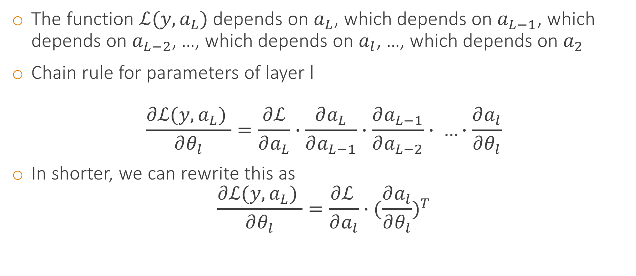
Backpropagation $⟺$ Chain rule!!!
The function $ℒ(y,a_{L})$ depends on $a_{L}$, which depends on $a_{L−1}$, which depends on $a_{L−2}$, …, which depends on $a_{l}$, …, which depends on $a_{2}$
Chain rule for parameters of layer l
$$\frac{∂ℒ(y,a_{L}) }{∂θ_{l}}=\frac{∂ℒ}{∂a_{L}}∙\frac{∂a_{L}}{∂a_{L−1}}∙\frac{∂a_{L−1}}{∂a_{L−2}}∙ …∙\frac{∂a_{l}}{∂θ_{l}}$$
In shorter, we can rewrite this as
$$\frac{∂ℒ(y,a_{L}) }{∂θ_{l}}=\frac{∂ℒ }{∂a_{l}}∙{(\frac{∂a_{l}}{∂θ_{l}})}^{T}$$
Gradient w.r.t. the module parameters
$$a_{L}\left(x;θ_{1,…,L} \right)=h_{L} (h_{L−1}\left(…h_{1}\left(x,θ_{1}\right),θ_{L−1}\right), θ_{L})$$

Slide 18
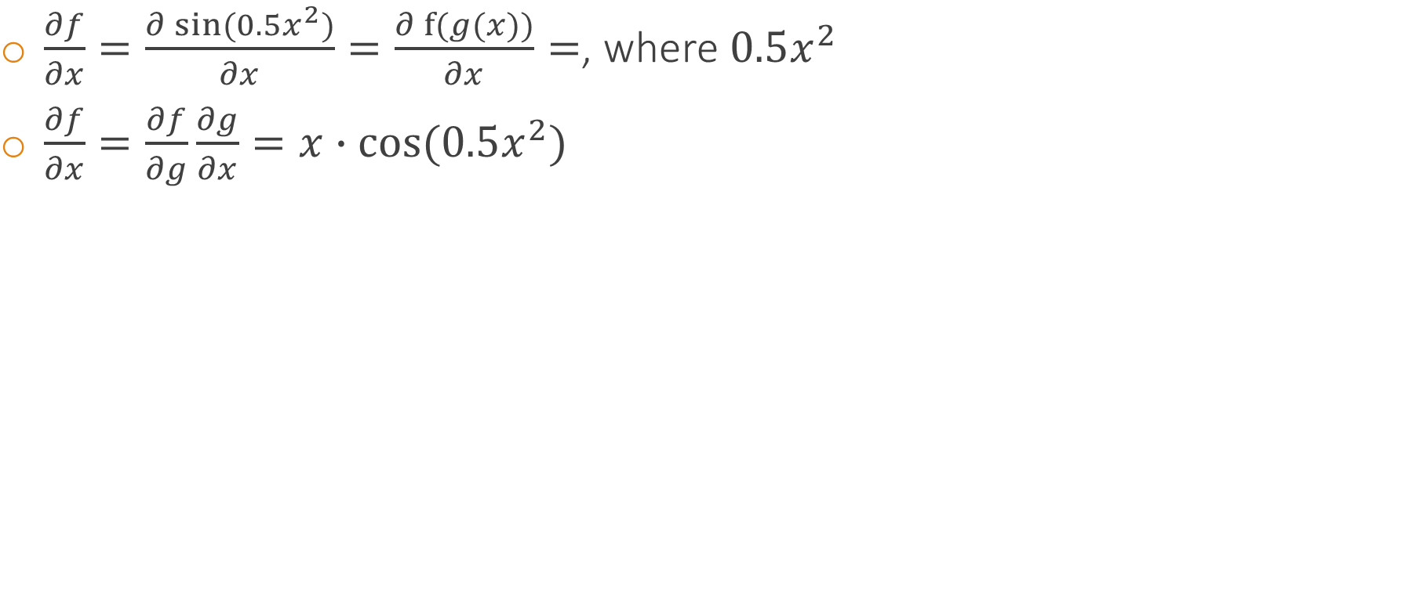
Chain rule in practice
$\frac{∂f}{∂x}=\frac{∂\sin{(0.5x^{2})}}{∂x}=\frac{∂f{(g(x))}}{∂x}=$, where $0.5x^{2}$
$\frac{∂f}{∂x}=\frac{∂f}{∂g}\frac{∂g}{∂x}=x∙cos{(0.5x^{2})}$

Slide 19
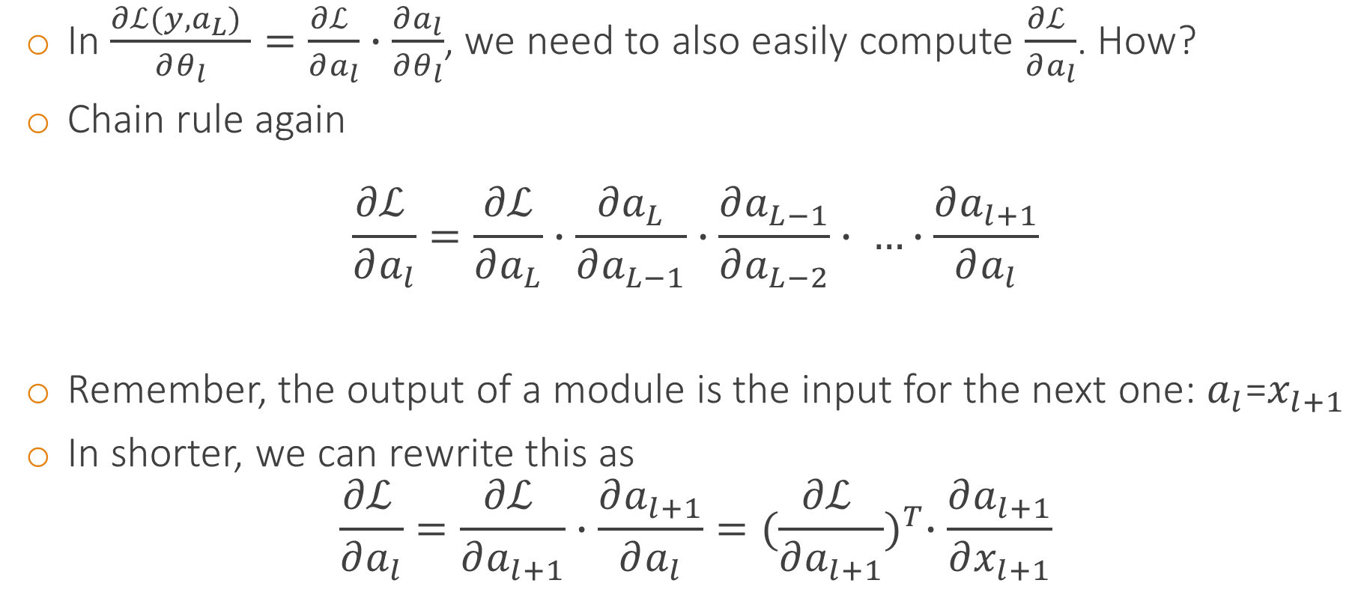
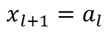


Backpropagation $⟺$ Chain rule!!!
In $\frac{∂ℒ(y,a_{L}) }{∂θ_{l}}=\frac{∂ℒ }{∂a_{l}}∙\frac{∂a_{l}}{∂θ_{l}}$, we need to also easily compute $\frac{∂ℒ }{∂a_{l}}$. How?
Chain rule again
$$\frac{∂ℒ }{∂a_{l}}=\frac{∂ℒ}{∂a_{L}}∙\frac{∂a_{L}}{∂a_{L−1}}∙\frac{∂a_{L−1}}{∂a_{L−2}}∙ …∙\frac{∂a_{l+1}}{∂a_{l}}$$
Remember, the output of a module is the input for the next one: $a_{l}$=$x_{l+1}$
In shorter, we can rewrite this as
$$\frac{∂ℒ }{∂a_{l}}=\frac{∂ℒ }{∂a_{l+1}}∙\frac{∂a_{l+1}}{∂a_{l}}={(\frac{∂ℒ }{∂a_{l+1}})}^{T}∙\frac{∂a_{l+1}}{∂x_{l+1}}$$
$${a_{l+1}=h}_{l+1}(x_{l+1};θ_{l+1})$$
$$x_{l+1}=a_{l}$$
$${a_{l}=h}_{l}(x_{l};θ_{l})$$
Recursive rule (good for us)!!!
Gradient w.r.t. the module input

Slide 20
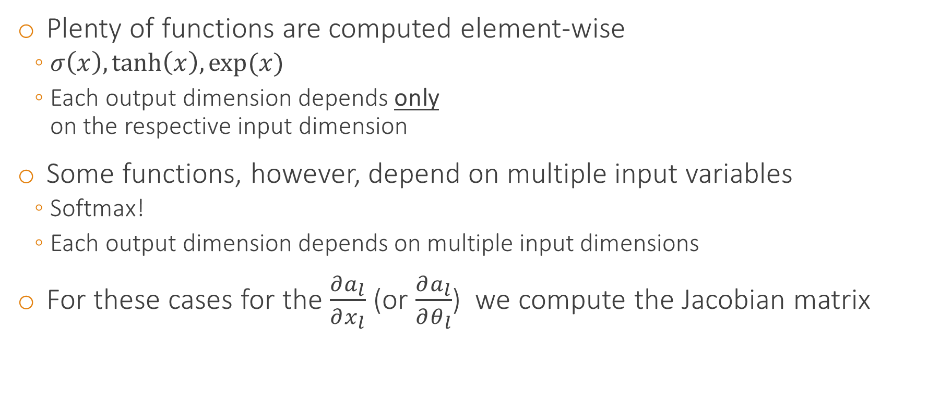
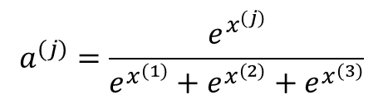
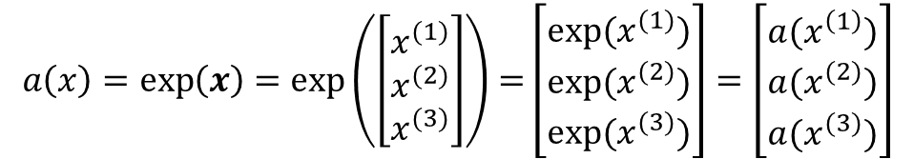
Backpropagation for multivariate functions $f(x)$
Plenty of functions are computed element-wise
$σ\left(x\right), tanh\left(x\right),\exp{(x)}⁡$
Each output dimension depends only on the respective input dimension
Some functions, however, depend on multiple input variables
Softmax!
Each output dimension depends on multiple input dimensions
For these cases for the $\frac{∂a_{l}}{∂x_{l}}$ (or $\frac{∂a_{l}}{∂θ_{l}}$) we compute the Jacobian matrix
$$a\left(x\right)=exp\left(x\right)=\exp\left(\left[\begin{matrix}x^{(1)} \\ x^{(2)} \\ x^{(3)}\end{matrix}\right]\right)=\left[\begin{matrix}exp⁡(x^{(1)}) \\ exp⁡(x^{(2)}) \\ exp⁡(x^{(3)})\end{matrix}\right]=\left[\begin{matrix}a(x^{\left(1\right)}) \\ {a(x}^{(2)}) \\ {a(x}^{(3)})\end{matrix}\right]$$
$$a^{(j)}=\frac{e^{x^{(j)}}}{e^{x^{(1)}}+e^{x^{(2)}}+e^{x^{(3)}}}$$

Slide 21
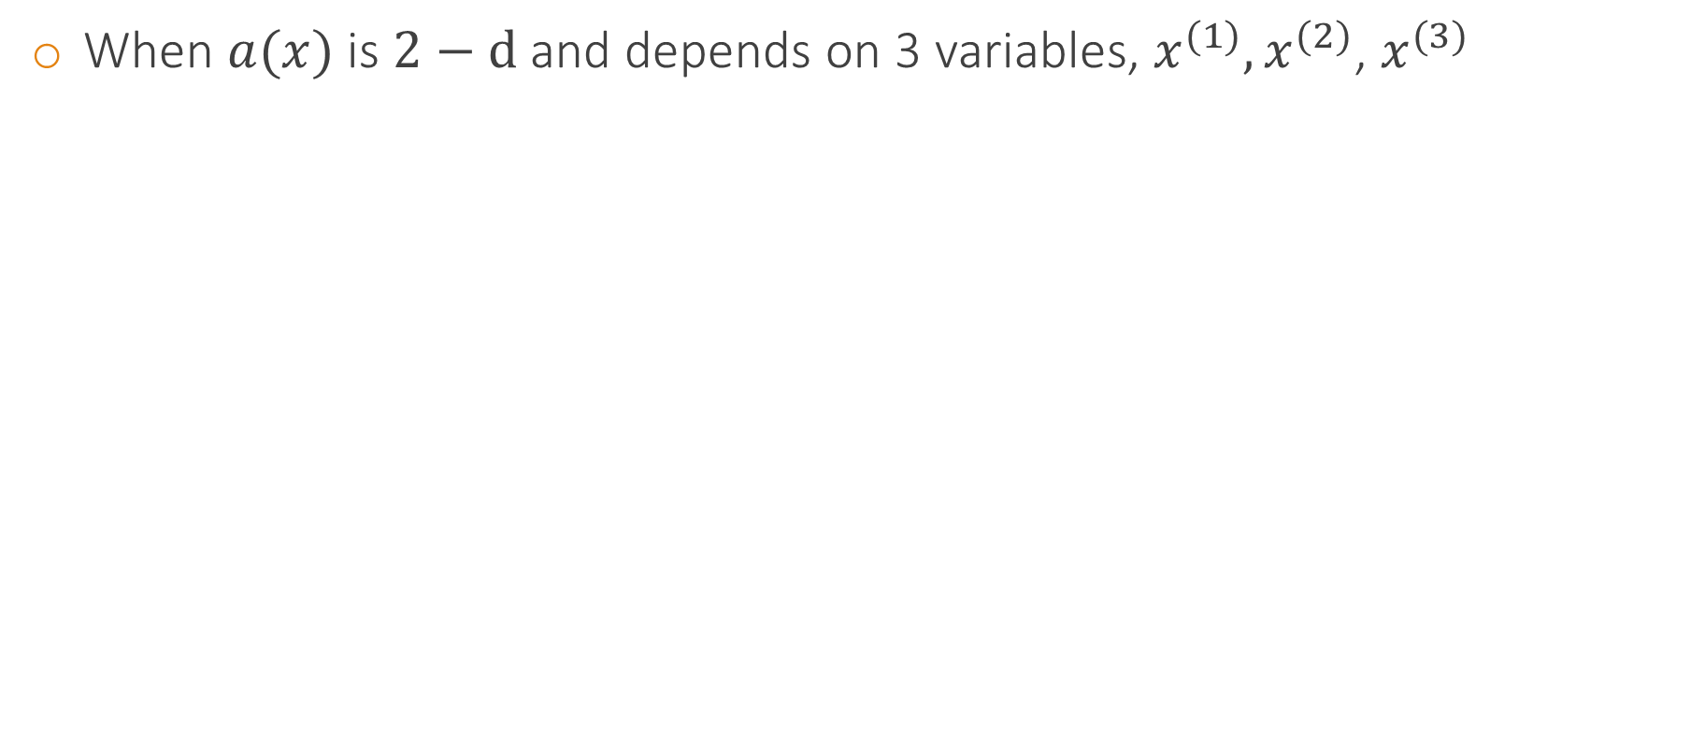
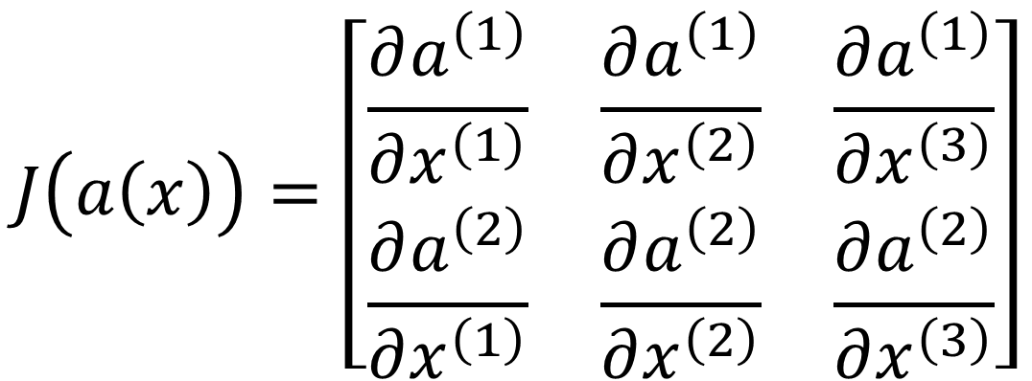
The Jacobian
When $a(x)$ is $2−d$ and depends on 3 variables, $x^{(1)},x^{(2)}$, $x^{(3)}$
$$J\left(a\left(x\right)\right)=\left[\begin{matrix}\frac{∂a^{\left(1\right)}}{∂x^{\left(1\right)}} & \frac{∂a^{\left(1\right)}}{∂x^{\left(2\right)}} & \frac{∂a^{\left(1\right)}}{∂x^{\left(3\right)}} \\ \frac{∂a^{\left(2\right)}}{∂x^{\left(1\right)}} & \frac{∂a^{\left(2\right)}}{∂x^{\left(2\right)}} & \frac{∂a^{\left(2\right)}}{∂x^{\left(3\right)}}\end{matrix}\right]$$

Slide 22
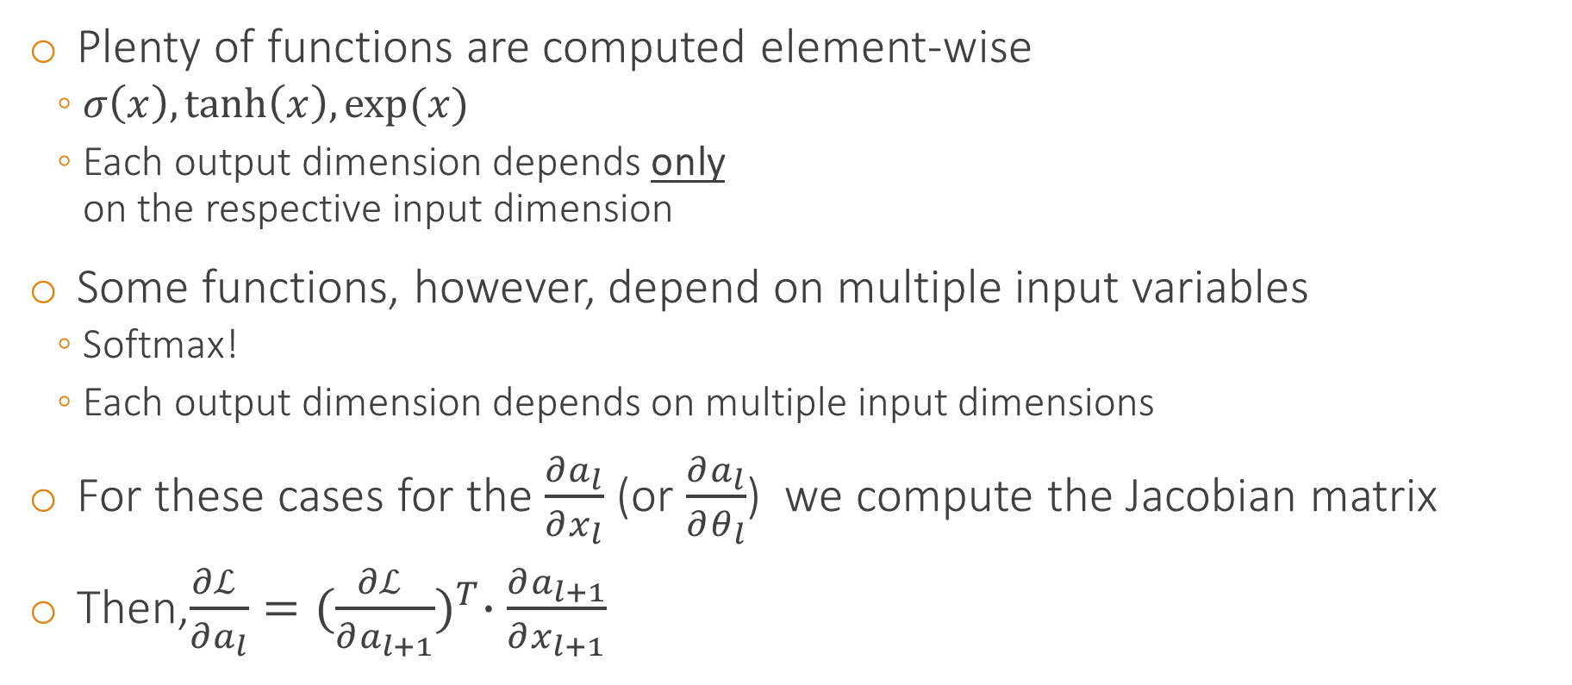
Backpropagation for multivariate functions $f(x)$
Plenty of functions are computed element-wise
$σ\left(x\right), tanh\left(x\right),\exp{(x)}⁡$
Each output dimension depends only on the respective input dimension
Some functions, however, depend on multiple input variables
Softmax!
Each output dimension depends on multiple input dimensions
For these cases for the $\frac{∂a_{l}}{∂x_{l}}$ (or $\frac{∂a_{l}}{∂θ_{l}}$) we compute the Jacobian matrix
Then,$\frac{∂ℒ }{∂a_{l}}={(\frac{∂ℒ }{∂a_{l+1}})}^{T}∙\frac{∂a_{l+1}}{∂x_{l+1}}$
$$a\left(x\right)=exp\left(x\right)=\exp\left(\left[\begin{matrix}x^{(1)} \\ x^{(2)} \\ x^{(3)}\end{matrix}\right]\right)=\left[\begin{matrix}exp⁡(x^{(1)}) \\ exp⁡(x^{(2)}) \\ exp⁡(x^{(3)})\end{matrix}\right]=\left[\begin{matrix}a(x^{\left(1\right)}) \\ {a(x}^{(2)}) \\ {a(x}^{(3)})\end{matrix}\right]$$
$$a^{(j)}=\frac{e^{x^{(j)}}}{e^{x^{(1)}}+e^{x^{(2)}}+e^{x^{(3)}}}$$

Slide 23
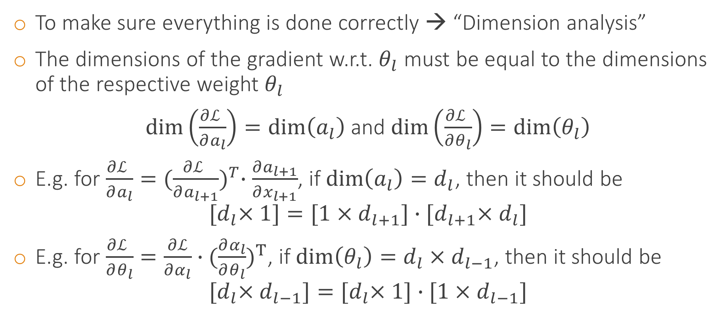
Dimension analysis
To make sure everything is done correctly → “Dimension analysis”
The dimensions of the gradient w.r.t. $θ_{l}$ must be equal to the dimensions of the respective weight $θ_{l}$
$\dim\left(\frac{∂ℒ }{∂a_{l}}\right)=\dim\left(a_{l}\right)$ and $\dim\left(\frac{∂ℒ }{∂θ_{l}}\right)=\dim\left(θ_{l}\right)$
E.g. for $\frac{∂ℒ }{∂a_{l}}={(\frac{∂ℒ }{∂a_{l+1}})}^{T}∙\frac{∂a_{l+1}}{∂x_{l+1}}$, if $\dim\left(a_{l}\right)=d_{l}$, then it should be
$${[d}_{l}×1]={[1×d}_{l+1}]∙{[d}_{l+1}×d_{l}]$$
E.g. for $\frac{∂ℒ }{∂θ_{l}}=\frac{∂ℒ}{∂α_{l}}∙{(\frac{∂α_{l}}{∂θ_{l}})}^{Τ}$, if $\dim\left(θ_{l}\right)=d_{l}×d_{l−1}$, then it should be
$${[d}_{l}×d_{l−1}]={[d}_{l}×1]∙[1×d_{l−1}]$$

Slide 24
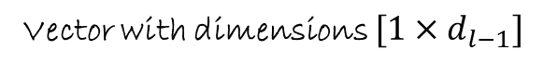
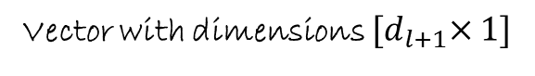
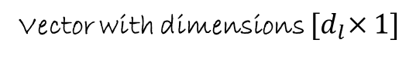
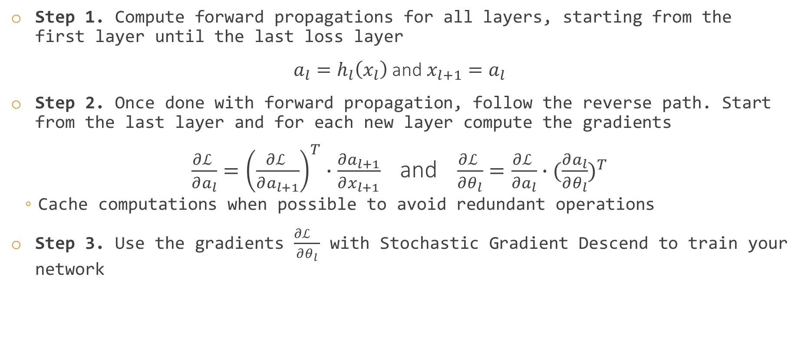
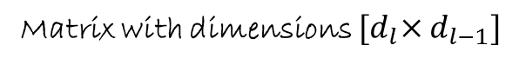
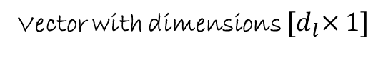
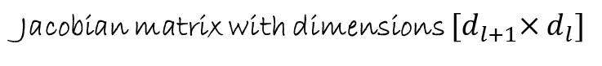
Backpropagation again
Step 1. Compute forward propagations for all layers, starting from the first layer until the last loss layer
$a_{l}=h_{l}\left(x_{l}\right)$ and $x_{l+1}=a_{l}$
Step 2. Once done with forward propagation, follow the reverse path. Start from the last layer and for each new layer compute the gradients
$\frac{∂ℒ }{∂a_{l}}={\left(\frac{∂ℒ }{∂a_{l+1}}\right)}^{T}∙\frac{∂a_{l+1}}{∂x_{l+1}}$ and $\frac{∂ℒ }{∂θ_{l}}=\frac{∂ℒ }{∂a_{l}}∙{(\frac{∂a_{l}}{∂θ_{l}})}^{T}$
Cache computations when possible to avoid redundant operations
Step 3. Use the gradients $\frac{∂ℒ }{∂θ_{l}}$ with Stochastic Gradient Descend to train your network
Vector with dimensions ${[d}_{l+1}×1]$
Matrix with dimensions ${[d}_{l}×d_{l−1}]$
Vector with dimensions $[1×d_{l−1}]$
Vector with dimensions ${[d}_{l}×1]$
Vector with dimensions ${[d}_{l}×1]$
Jacobian matrix with dimensions ${[d}_{l+1}×d_{l}]$

Slide 25
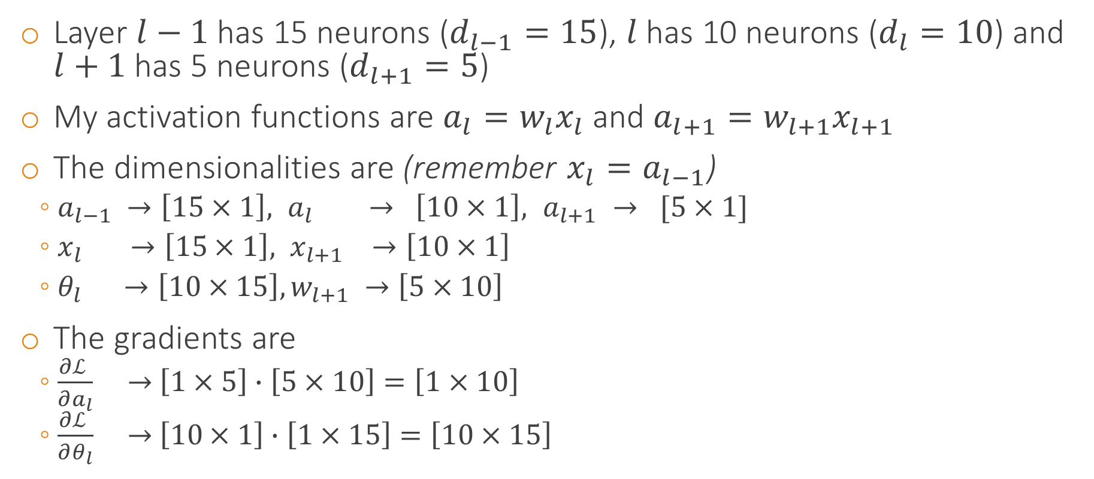
Practical example and dimensionality analysis
Layer $l−1$ has 15 neurons ($d_{l−1}=15$), $l$ has 10 neurons ($d_{l}=10$) and $l+1$ has 5 neurons ($d_{l+1}=5$)
My activation functions are $a_{l}=w_{l}x_{l}$ and $a_{l+1}=w_{l+1}x_{l+1}$
The dimensionalities are (remember $x_{l}=a_{l−1}$)
$a_{l−1} →\left[15×1\right],{ a}_{l} → \left[10×1\right],{ a}_{l+1} → [5×1]$
$x_{l} →\left[15×1\right], x_{l+1} →\left[10×1\right]$
$θ_{l} →\left[10×15\right], w_{l+1} →\left[5×10\right]$
The gradients are
$\frac{∂ℒ }{∂a_{l}} →$ $\left[1×5\right]∙\left[5×10\right]=\left[1×10\right]$
$\frac{∂ℒ }{∂θ_{l}} →$ $\left[10×1\right]∙\left[1×15\right]=\left[10×15\right]$

Slide 26
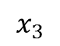
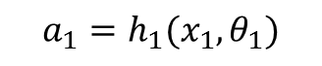
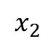
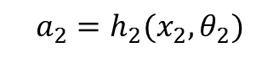







Backpropagation visualization
$${L=3, a}_{3}=h_{3}(x_{3})$$
$$ℒ$$
$$θ_{3}=∅$$
$$a_{2}=h_{2}(x_{2},θ_{2})$$
$$θ_{2}$$
$$a_{1}=h_{1}(x_{1},θ_{1})$$
$$θ_{1}$$
$$x_{1}$$
$$x_{2}$$
$$x_{3}$$
$$x_{4}$$

Slide 27













Backpropagation visualization at epoch $(t)$
Forward propagations
Compute and store ${ a}_{1}=h_{1}(x_{1})$
$$ℒ$$
Example
$$a_{3}=h_{3}(x_{3})$$
$$a_{1}={σ(θ_{1}x}_{1})$$
$$θ_{3}=∅$$
$$a_{2}=h_{2}(x_{2},θ_{2})$$
$$θ_{2}$$
Store!!!
$$a_{1}=h_{1}(x_{1},θ_{1})$$
$$θ_{1}$$
$$x_{1}$$
$$x_{2}$$
$$x_{3}$$
$$x_{4}$$

Slide 28














Backpropagation visualization at epoch $(t)$
Forward propagations
Compute and store ${ a}_{2}=h_{2}(x_{2})$
$$ℒ$$
Example
$${L=3, a}_{3}=h_{3}(x_{3})$$
$$a_{1}={σ(θ_{1}x}_{1})$$
$$θ_{3}=∅$$
$$a_{2}={σ(θ_{2}x}_{2})$$
$$a_{2}=h_{2}(x_{2},θ_{2})$$
$$θ_{2}$$
Store!!!
$$a_{1}=h_{1}(x_{1},θ_{1})$$
$$θ_{1}$$
$$x_{1}$$
$$x_{2}$$
$$x_{3}$$
$$x_{4}$$

Slide 29














Backpropagation visualization at epoch $(t)$
Forward propagations
Compute and store ${ a}_{3}=h_{3}(x_{3})$
$$ℒ$$
Example
$${L=3, a}_{3}=h_{3}(x_{3})$$
$$a_{1}={σ(θ_{1}x}_{1})$$
$$θ_{3}=∅$$
$$a_{2}={σ(θ_{2}x}_{2})$$
$$a_{2}=h_{2}(x_{2},θ_{2})$$
$$a_{3}={\left\|y−x_{3}\right\|}^{2}$$
$$θ_{2}$$
$$a_{1}=h_{1}(x_{1},θ_{1})$$
Store!!!
$$θ_{1}$$
$$x_{1}$$
$$x_{2}$$
$$x_{3}$$
$$x_{4}$$

Slide 30














Backpropagation visualization at epoch $(t)$
Backpropagation
$$ℒ$$
Example
$${ a}_{3}=h_{3}(x_{3})$$
$$a_{3}=ℒ\left(y,x_{3}\right)=h_{3}(x_{3})={0.5 \left\|y−x_{3}\right\|}^{2}$$
$\frac{∂ℒ }{∂a_{3}}= …$ ← Direct computation
$$θ_{3}=∅$$
$$\frac{∂ℒ }{∂x_{3}}=−(y−x_{3})$$
$$\frac{∂ℒ}{∂θ_{3}}$$
$$a_{2}=h_{2}(x_{2},θ_{2})$$
$$θ_{2}$$
$$a_{1}=h_{1}(x_{1},θ_{1})$$
$$θ_{1}$$
$$x_{1}$$
$$x_{2}$$
$$x_{3}$$
$$x_{4}$$

Slide 31





















Backpropagation visualization at epoch $(t)$
Example
Backpropagation
$$ℒ$$
$$ℒ\left(y,x_{3}\right)={0.5 \left\|y−x_{3}\right\|}^{2}$$
$$a_{3}=h_{3}(x_{3 })$$
$$x_{3}=a_{2}$$
$$\frac{∂ℒ }{∂a_{2}}=\frac{∂ℒ }{∂a_{3}}∙\frac{∂a_{3}}{∂a_{2}}$$
$$θ_{3}=∅$$
$$a_{2}={σ(θ_{2}x}_{2})$$
$$\frac{∂ℒ}{∂a_{2}}=\frac{∂ℒ}{∂x_{3}}={−(y−x}_{3})$$
$$\frac{∂ℒ }{∂θ_{2}}=\frac{∂ℒ }{∂a_{2}}∙\frac{∂a_{2}}{∂θ_{2}}$$
$$a_{2}=h_{2}(x_{2},θ_{2})$$
$$θ_{2}$$
$$∂σ(x)=σ(x)(1−σ(x))$$
$$a_{1}=h_{1}(x_{1},θ_{1})$$
$$\frac{∂a_{2}}{∂θ_{2}}=x_{2}{σ(θ_{2}x}_{2})(1−{σ(θ_{2}x}_{2}))$$
$=x_{2}a_{2}(1−a_{2})$
$$θ_{1}$$
$$x_{1}$$
$$x_{2}$$
$$x_{3}$$
$$x_{4}$$
$$\frac{∂ℒ }{∂a_{2}}={−(y−x}_{3})$$
$$\frac{∂ℒ }{∂θ_{2}}=\frac{∂ℒ }{∂a_{2}}x_{2}a_{2}(1−a_{2})$$
Stored during forward computations

Slide 32





















Backpropagation visualization at epoch $(t)$
Example
Backpropagation
$$ℒ\left(y,a_{3}\right)={0.5 \left\|y−a_{3}\right\|}^{2}$$
$$ℒ$$
$$a_{3}=h_{3}(x_{3})$$
$$a_{2}={σ(θ_{2}x}_{2})$$
$$\frac{∂ℒ }{∂a_{1}}=\frac{∂ℒ }{∂a_{2}}∙\frac{∂a_{2}}{∂a_{1}}$$
$$x_{2}=a_{1}$$
$$θ_{3}=∅$$
$$a_{1}={σ(θ_{1}x}_{1})$$
$$\frac{∂ℒ }{∂θ_{1}}=\frac{∂ℒ }{∂a_{1}}∙\frac{∂a_{1}}{∂θ_{1}}$$
$$a_{2}=h_{2}(x_{2},θ_{2})$$
$$\frac{∂a_{2}}{∂a_{1}}=\frac{∂a_{2}}{∂x_{2}}=θ_{2}a_{2}(1−a_{2})$$
$$θ_{2}$$
$$\frac{∂a_{1}}{∂θ_{1}}=x_{1}a_{1}(1−a_{1})$$
$$a_{1}=h_{1}(x_{1},θ_{1})$$
$$θ_{1}$$
$$\frac{∂ℒ }{∂a_{1}}=\frac{∂ℒ }{∂a_{2}}θ_{2}a_{2}(1−a_{2})$$
$$x_{1}$$
$$x_{2}$$
$$x_{3}$$
$$x_{4}$$
$$\frac{∂ℒ }{∂θ_{1}}=\frac{∂ℒ }{∂a_{1}}x_{1}a_{1}(1−a_{1})$$
Computed from the exact previous backpropagation step (Remember, recursive rule)

Slide 33






Backpropagation visualization at epoch $(t+1)$
Forward propagations
Compute and store ${ a}_{1}=h_{1}(x_{1})$
$$ℒ$$
Example
$${L=3, a}_{3}=h_{3}(x_{3})$$
$$a_{1}={σ(θ_{1}x}_{1})$$
$$θ_{3}=∅$$
$$a_{2}=h_{2}(x_{2},θ_{2})$$
$$θ_{2}$$
Store!!!
$$a_{1}=h_{1}(x_{1},θ_{1})$$
$$θ_{1}$$
$$x_{1}$$
$$x_{2}$$
$$x_{3}$$
$$x_{4}$$

Slide 34





Backpropagation visualization at epoch $(t+1)$
Forward propagations
Compute and store ${ a}_{2}=h_{2}(x_{2})$
$$ℒ$$
Example
$${L=3, a}_{3}=h_{3}(x_{3})$$
$$a_{1}={σ(θ_{1}x}_{1})$$
$$θ_{3}=∅$$
$$a_{2}={σ(θ_{2}x}_{2})$$
$$a_{2}=h_{2}(x_{2},θ_{2})$$
$$θ_{2}$$
Store!!!
$$a_{1}=h_{1}(x_{1},θ_{1})$$
$$θ_{1}$$
$$x_{1}$$
$$x_{2}$$
$$x_{3}$$
$$x_{4}$$

Slide 35





Backpropagation visualization at epoch $(t+1)$
Forward propagations
Compute and store ${ a}_{3}=h_{3}(x_{3})$
$$ℒ$$
Example
$${L=3, a}_{3}=h_{3}(x_{3})$$
$$a_{1}={σ(θ_{1}x}_{1})$$
$$θ_{3}=∅$$
$$a_{2}={σ(θ_{2}x}_{2})$$
$$a_{2}=h_{2}(x_{2},θ_{2})$$
$$a_{3}={\left\|y−x_{3}\right\|}^{2}$$
$$θ_{2}$$
$$a_{1}=h_{1}(x_{1},θ_{1})$$
Store!!!
$$θ_{1}$$
$$x_{1}$$
$$x_{2}$$
$$x_{3}$$
$$x_{4}$$

Slide 36





Backpropagation visualization at epoch $(t+1)$
Backpropagation
$$ℒ$$
Example
$${ a}_{3}=h_{3}(x_{3})$$
$$a_{3}=ℒ\left(y,x_{3}\right)=h_{3}(x_{3})={0.5 \left\|y−x_{3}\right\|}^{2}$$
$\frac{∂ℒ }{∂a_{3}}= …$ ← Direct computation
$$θ_{3}=∅$$
$$\frac{∂ℒ }{∂x_{3}}=−(y−x_{3})$$
$$\frac{∂ℒ}{∂θ_{3}}$$
$$a_{2}=h_{2}(x_{2},θ_{2})$$
$$θ_{2}$$
$$a_{1}=h_{1}(x_{1},θ_{1})$$
$$θ_{1}$$
$$x_{1}$$
$$x_{2}$$
$$x_{3}$$
$$x_{4}$$

Slide 37





Backpropagation visualization at epoch $(t+1)$
Example
Backpropagation
$$ℒ$$
$$ℒ\left(y,x_{3}\right)={0.5 \left\|y−x_{3}\right\|}^{2}$$
$$a_{3}=h_{3}(x_{3 })$$
$$x_{3}=a_{2}$$
$$\frac{∂ℒ }{∂a_{2}}=\frac{∂ℒ }{∂a_{3}}∙\frac{∂a_{3}}{∂a_{2}}$$
$$θ_{3}=∅$$
$$a_{2}={σ(θ_{2}x}_{2})$$
$$\frac{∂ℒ}{∂a_{2}}=\frac{∂ℒ}{∂x_{3}}={−(y−x}_{3})$$
$$\frac{∂ℒ }{∂θ_{2}}=\frac{∂ℒ }{∂a_{2}}∙\frac{∂a_{2}}{∂θ_{2}}$$
$$a_{2}=h_{2}(x_{2},θ_{2})$$
$$θ_{2}$$
$$∂σ(x)=σ(x)(1−σ(x))$$
$$a_{1}=h_{1}(x_{1},θ_{1})$$
$$\frac{∂a_{2}}{∂θ_{2}}=x_{2}{σ(θ_{2}x}_{2})(1−{σ(θ_{2}x}_{2}))$$
$=x_{2}a_{2}(1−a_{2})$
$$θ_{1}$$
$$x_{1}$$
$$x_{2}$$
$$x_{3}$$
$$x_{4}$$
$$\frac{∂ℒ }{∂a_{2}}={−(y−x}_{3})$$
$$\frac{∂ℒ }{∂θ_{2}}=\frac{∂ℒ }{∂a_{2}}x_{2}a_{2}(1−a_{2})$$
Stored during forward computations

Slide 38





Backpropagation visualization at epoch $(t+1)$
Example
Backpropagation
$$ℒ\left(y,a_{3}\right)={0.5 \left\|y−a_{3}\right\|}^{2}$$
$$ℒ$$
$$a_{3}=h_{3}(x_{3})$$
$$a_{2}={σ(θ_{2}x}_{2})$$
$$\frac{∂ℒ }{∂a_{1}}=\frac{∂ℒ }{∂a_{2}}∙\frac{∂a_{2}}{∂a_{1}}$$
$$x_{2}=a_{1}$$
$$θ_{3}=∅$$
$$a_{1}={σ(θ_{1}x}_{1})$$
$$\frac{∂ℒ }{∂θ_{1}}=\frac{∂ℒ }{∂a_{1}}∙\frac{∂a_{1}}{∂θ_{1}}$$
$$a_{2}=h_{2}(x_{2},θ_{2})$$
$$\frac{∂a_{2}}{∂a_{1}}=\frac{∂a_{2}}{∂x_{2}}=θ_{2}a_{2}(1−a_{2})$$
$$θ_{2}$$
$$\frac{∂a_{1}}{∂θ_{1}}=x_{1}a_{1}(1−a_{1})$$
$$a_{1}=h_{1}(x_{1},θ_{1})$$
$$θ_{1}$$
$$\frac{∂ℒ }{∂a_{1}}=\frac{∂ℒ }{∂a_{2}}θ_{2}a_{2}(1−a_{2})$$
$$x_{1}$$
$$x_{2}$$
$$x_{3}$$
$$x_{4}$$
$$\frac{∂ℒ }{∂θ_{1}}=\frac{∂ℒ }{∂a_{1}}x_{1}a_{1}(1−a_{1})$$
Computed from the exact previous backpropagation step (Remember, recursive rule)

Slide 39

Some practical tricks of the trade
For classification use cross-entropy loss
Use Stochastic Gradient Descent on mini-batches
Shuffle training examples at each new epoch
Normalize input variables to $\left(μ, σ^{2}\right)=(0,1)$
Notes:
Add more practical stuff in the next lecture with the optimizations

Slide 40

Everything is a module

Slide 41


Neural network models
A neural network model is a series of hierarchically connected functions
This hierarchies can be very, very complex
Forward connections
(Feedforward architecture)
$$Input$$
$$h_{1}(x_{i};θ)$$
$$h_{2}(x_{i};θ)$$
$$h_{3}(x_{i};θ)$$
$$h_{4}(x_{i};θ)$$
$$h_{5}(x_{i};θ)$$
$$Loss$$
$$h(x_{i};θ)$$
$$h_{2}(x_{i};θ)$$
$$h_{3}(x_{i};θ)$$
$$h_{5}(x_{i};θ)$$
Functions are implemented as Modules
Interweaved connections (Directed Acyclic Graph architecture- DAGNN)
Functions
$$Input$$
$$h_{1}(x_{i};θ)$$
$$h_{4}(x_{i};θ)$$
$$Loss$$
$$θ$$
$$h_{2}(x_{i};θ)$$
$$h_{4}(x_{i};θ)$$
$$Input$$
$$h_{1}(x_{i};θ)$$
$$h_{2}(x_{i};θ)$$
$$h_{3}(x_{i};θ)$$
$$h_{4}(x_{i};θ)$$
$$h_{5}(x_{i};θ)$$
$$Loss$$
Loopy connections (Recurrent architecture, special care needed)

Slide 42


Linear module
Activation function $a=θx$
Gradient with respect to the input $\frac{∂a}{∂x}=θ$
Gradient with respect to the parameters $\frac{∂a}{∂θ}=x$

Slide 43


Sigmoid module
Activation function $a=σ\left(x\right)=\frac{1}{1+e^{−x}}$
Gradient wrt the input $\frac{∂a}{∂x}=σ(x)(1−σ(x))$
Gradient wrt the input $\frac{∂σ\left(θx\right)}{∂x}=θ∙σ\left(θx\right)\left(1−σ\left(θx\right)\right)$
Gradient wrt the parameters $\frac{∂σ\left(θx\right)}{∂θ}=x∙σ(θx)(1−σ(θx))$
Output can be interpreted as probability
Always bounds the outputs between 0 and 1, so the network cannot overshoot
Gradients can be small in deep networks because we always multiply with <1
The gradients at the tails are flat to 0, hence no serious updates
Overconfident, but not necessarily “correct”, neurons get stuck

Slide 44



Simplifying backpropagation equations
We often want to apply a non-linearity $σ(…)$ on top of an activation $θx$
$$a=σ(θx)$$
This way we end up with quite complicated backpropagation equations
Since everything is a module, we can decompose this to 2 modules
We now have to perform two backpropagation steps instead of one
But now our gradients are simpler
The complications happen when non-linear functions are parametric
We avoid taking the extra gradients w.r.t. parameters inside a non-linearity
This is usually how networks are implemented in Torch
$$a_{1}=θx$$
$$a_{2}=σ(a_{1})$$

Slide 45


Tanh module
Activation function $a=tanh\left(x\right)=\frac{e^{x}−e^{−x}}{e^{x}+e^{−x}}$
Gradient with respect to the input $\frac{∂a}{∂x}=1−\tanh^{2}(x)$
Similar to sigmoid, but with different output range
$[−1, +1]$ instead of $\left[0, +1\right]$
Stronger gradients, because data is centered around 0 (not 0.5)
Less bias to hidden layer neurons as now outputs can be both positive and negative (more likely to have zero mean in the end)

Slide 46

Softmax module
Activation function $a^{(k)}=softmax(x^{(k)})=\frac{e^{x^{(k)}}}{\sum_{j}{e^{x^{(j)}}}}$
This activation function is mostly used for making decisions in a form of a probability
$\sum_{k=1}^{K}{a^{(k)}=1 }$for $K$ classes
Exploiting the fact that $e^{a+b}=e^{a}e^{b}$, we usually compute
$a^{(k)}=\frac{e^{x^{(k)}−μ}}{\sum_{j}{e^{x^{(j)}−μ}}}, μ=\max_{k}{x^{(k)}}$ as $\frac{e^{x^{(k)}−μ}}{\sum_{j}{e^{x^{(j)}−μ}}}=\frac{e^{μ}e^{x^{(k)}}}{e^{μ}\sum_{j}{e^{x^{(j)}}}}=\frac{e^{x^{(k)}}}{\sum_{j}{e^{x^{(j)}}}}$
This provides better stability because avoids exponentianting large numbers

Slide 47


Euclidean loss module
Activation function $a(x)=$ ${0.5 \left\|y−x\right\|}^{2}$
Mostly used to measure the loss in regression tasks
Gradient with respect to the input $\frac{∂a}{∂x}=x−y$

Slide 48

Cross-entropy loss (log-loss or log-likelihood) module
Activation function $a\left(x\right)=−\sum_{k=1}^{K}{y^{(k)}\log{x^{(k)},{ y}^{(k)}=\{0, 1\}}}$
Gradient with respect to the input $\frac{∂a}{∂x^{(k)}}=−\frac{1}{x^{(k)}}$
The cross-entropy loss is the most popular classification losses for classifiers that output probabilities (not SVM)
The cross-entropy loss couples well with certain input activations, such as the softmax module or the sigmoid module
Often the gradients of the cross-entropy loss are computed in conjunction with the activation function from the previous layer
Generalization of logistic regression for more than 2 outputs

Slide 49

More specific modules for later
There are many more modules that are quite often used in Deep Learning
Convolutional filter modules
Rectified Linear Unit (ReLU) module
Parametric ReLU module
Regularization modules
Dropout
Normalization modules
$ℓ_{2}$-normalization
Loss modules
Hinge loss
and others, which we are going to discuss later in the course

Slide 50

Make your own module

Slide 51

New modules
Everything can be a module, given some ground rules
How to make our own module?
Write a function that follows the ground rules
Needs to be (at least) first-order differentiable (almost) everywhere
Hence, we need to be able to compute the
$\frac{∂a(x;θ)}{∂x}$ and $\frac{∂a(x;θ)}{∂θ}$

Slide 52
A module of modules
As everything can be a module, a module of modules could also be a module
In fact, [Lin2014] proposed a Network-in-Network architecture
We can therefore make new building blocks as we please, if we expect them to be used frequently
Of course, the same rules for the eligibility of modules still apply

Slide 53

Radial Basis Function (RBF) Network module
Assume we want to build an RBF module
$$a=\sum_{j}{u_{j}\exp{(−β_{j}{(x−w_{j})}^{2})}}$$
To avoid computing the full derivations, we can decompose this module into a cascade of modules
$a_{1}={(x−w)}^{2}→a_{2}=\exp\left(−{βa}_{1}\right)→a_{3}=ua_{2}→a_{4}=plus(…,a_{3}^{\left(j\right)}, …)$
An RBF module is good for regression problems, in which cases it is followed by a Euclidean loss module
The Gaussian centers $w_{j}$ can be initialized externally, e.g. with k-means

Slide 54











An RBF visually
$$a_{5}={\left\|y−a_{4}\right\|}^{2}$$
RBF module
$$a_{4}=plus(a_{3})$$
$$α_{3}^{(1)}= u_{1}α_{2}^{(1)}$$
$$α_{3}^{(2)}= u_{2}α_{2}^{(2)}$$
$$α_{3}^{(3)}= u_{3}α_{2}^{(3)}$$
$$α_{2}^{(1)}=\exp{(−β_{1}α_{1}^{(1)})}$$
$$α_{2}^{(2)}=\exp{(−β_{1}α_{1}^{(2)})}$$
$$α_{2}^{(3)}=\exp{(−β_{1}α_{1}^{(3)})}$$
$$α_{1}^{(1)}={(x− w_{1})}^{2}$$
$$α_{1}^{(2)}={(x− w_{1})}^{2}$$
$$α_{1}^{(3)}={(x− w_{1})}^{2}$$
$a_{1}={(x−w)}^{2}→a_{2}=\exp\left(−{βa}_{1}\right)→a_{3}=ua_{2}→a_{4}=plus(…,a_{3}^{\left(j\right)}, …)$

Slide 55


Gradient check
Original gradient definition: $\frac{df(x)}{dx}={lim⁡}_{h→0}⁡\frac{f(x+h)}{Δh}$
The most dangerous part when implementing new modules is to get your gradients right
The math might be wrong, the code might be wrong, …
Check your module with gradient checks.
Compare your explicit gradient with computational gradient $g\left(θ^{(i)}\right)≈\frac{a\left(θ+ε\right)−a\left(θ−ε\right)}{2ε}$
$${Δ\left(θ^{(i)}\right)=\left\|\frac{∂a(x;θ^{(i)})}{∂θ^{(i)}} −g\left(θ^{(i)}\right)\right\|}^{2}$$
If result is smaller than $δ∈({10}^{−4},{10}^{−7})$, then your gradients are good
Perturb one parameter $θ^{(i)}$ at a time, $θ^{(i)}+ε$, then check its $Δ\left(θ^{(i)}\right)$
Do not perturb the whole parameter vector $θ+ε$, it will give wrong results
Good practice: check your network gradients too

Slide 56

Checking your gradients in practice (for a module)
Import our module
Call the Jacobian module , which can check the Jacobian matrix
Generate an instance for our new module
Check the Jacobians for our new module

Slide 57

Checking your gradients in practice (for a network)
To make it faster, sample few only dimensions. Sample carefully though, when testing whole network
To make it faster, few only training points

Slide 58
Come up with new modules
What about trigonometric modules
Or polynomial modules
Or new loss modules
In the Lab Assignment 2 you will have the chance to think of new modules

Slide 59


Implementation of basic networks and modules in Torch

Slide 60

Building a module
For a new module you must re-implement two functions in Torch
One to compute the result of the forward propagation for the module
And one computing the gradient of the loss w.r.t. the input
$$\frac{∂ℒ(a_{L}, y)}{∂x}=\frac{∂ℒ }{∂a_{above}}∙\frac{∂a}{∂x}$$
Of course you can implement other helper functions too
If, and only if, your module is parametric, namely has trainable parameters
You must also implement a function for the gradient of the loss w.r.t. the parameters
$$\frac{∂ℒ(a_{L}, y)}{∂θ}=\frac{∂ℒ }{∂a}∙\frac{∂a}{∂θ}$$
If your trainable parameters are boil down to a linear product $θx$, you can simply cascade this module and avoid taking an extra gradient
$$a_{1}=θx→a_{2}=nonlinear(a_{1})$$
mymodule.updateOutput(…)
mymodule.updateGradInput(…)
mymodule.updateGradParameters(…)

Slide 61

Make a module in Torch
Probably you will need to define some class variables
The forward propagation function
The backward propagation function wrt the input of the module
The backward propagation function wrt the parameters of the module
If module is not parametric, you don’t need to implement this function

Slide 62
Summary
We introduced how does the machine learning paradigm for neural networks
We described the backpropagation algorithm, which is the backbone for neural network training
We explained the neural network in terms of modular architecture and described various possible architectures
We described different neural network modules, as well as how to implement and how to check your own module

Slide 63
Next lecture
We are going to see how to use backpropagation to optimize our neural network
We are going to review different methods and algorithms for optimizing our neural network, especially our deep networks, better
We are going to revisit different learning paradigms, e.g. what loss functions should be used for different machine learning tasks
And if we have time, some more advanced modules

Slide 64

More advanced modules

Slide 65

The plus module
Activation function $a=plus(x^{\left(1\right)}, …,x^{(k)})=\sum_{k}{x^{(k)}}$
Gradient with respect to the input $\frac{∂a}{∂x^{(k)}}=1$

Slide 66

The branch module
Activation function $a^{(k)}=x, k=1, …, K$
Gradient with respect to the input $\frac{∂a^{(k)}}{∂x}=1⟹\frac{∂ℒ }{∂a_{l}}=\frac{∂ℒ }{∂a_{l+1}}∙\frac{∂a_{3}}{∂a_{2}}$

Slide 67

The switch module
Activation function $a(x^{\left(1\right)}, …,x^{(K)};ρ)=\sum_{k}{δ(ρ−k)x^{(k)}}$
Gradient with respect to the input $\frac{∂a}{∂x^{(k)}}=δ(ρ−k)$

Slide 68

The logsum module
Activation function $a=−\frac{1}{β}\log{\sum_{k}{\exp{(−βx^{(k)})} }}$
Gradient with respect to the input $\frac{∂a}{∂x^{(k)}}=\frac{\exp{(−βx^{(k)})}}{\sum_{j}{\exp{(−βx^{(j)})}}}$

Slide 69
The logsum module

Slide 70
Log-likelihood and and logsum module

Slide 71




Backpropagation visualization
$$Loss$$
$$h_{2}(x_{i};θ)$$
$$h_{1}(x_{i};θ)$$
$$Input$$

